Slide 1
Human Body Fall Detection
Ashwani Singla
Kumar Halder
Ranjit Singh

Slide 2
Overview
Short Literature Review
Scope of the Project
Approach Used
Demo
Future Scope

Slide 3
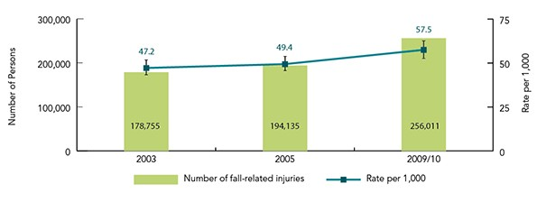
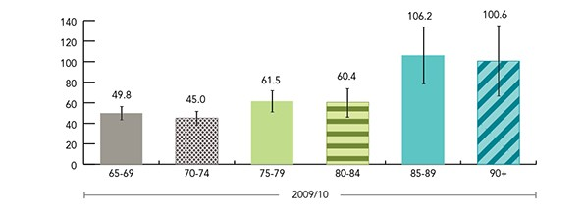
Problem
Estimated cases and rates (per 1,000) of injuries resulting from a fall, age 65+, Canada, 2003, 2005, 2009/2010 (95% CIs shown)
Estimated rates (per 1,000) of injuries resulting from a fall by age group, age 65+, Canada, 2009/10 (95% CIs shown)
https://www.canada.ca/en/public-health/services/health-promotion/aging-seniors/publications/publications-general-public/seniors-falls-canada-second-report.html

Slide 4
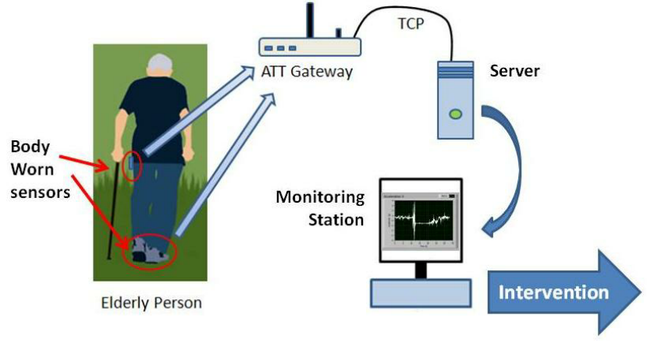
Alternate Techniques
Use Special hardware or devices which have accelerometer and gyroscope to track human motion
Accurate fall detection using 3-axis accelerometer sensor and MLF algorithm
Anice Jahanjoo ; Marjan Naderan Tahan ; Mohammad Javad Rashti

Slide 5
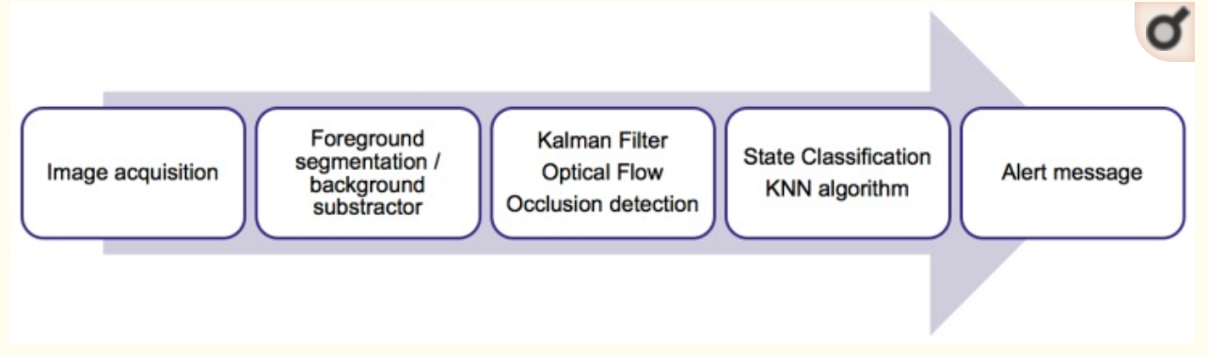
Build neural network
Home Camera-Based Fall Detection System for the Elderly
Koldo de Miguel
Alberto Brunete
Miguel Hernando
Ernesto Gambao†

Slide 6
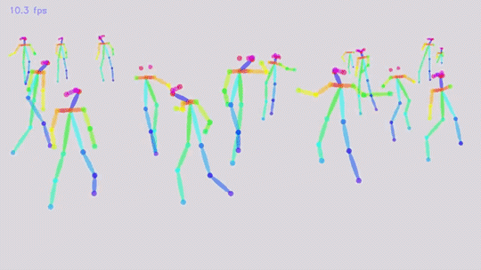
Action detection deep network approaches such as OpenPose
Realtime Multi-Person 2D Pose Estimation using Part Affinity Fields
Zhe Cao Tomas Simon Shih-En Wei Yaser Sheikh

Slide 7
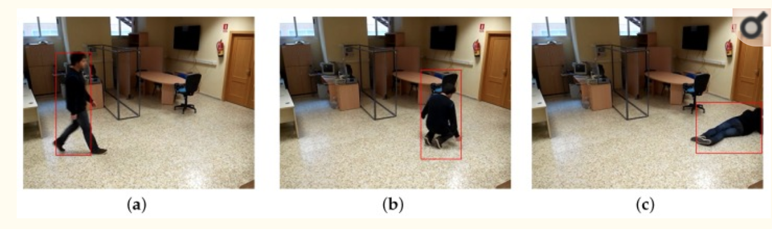
Traditional Computer vision
Frame to Frame Comparison

Slide 8
Big Obstacle
Person falling towards camera
Different light conditions
Solution
Human Fall Detection by Using the Body Vector
Siriporn Pattamaset
Theekapun Charoenpong
Patsama Charoenpong
Chamaporn Chianrabutra

Slide 9
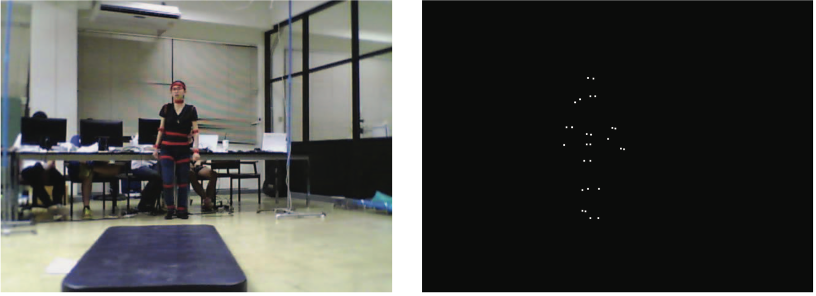
Dependency
Not Feasible !!!

Slide 10
Finding ROI
Foreground Extraction Using techniques like MOG2
Are very inefficient in case of bad quality videos and can give large number of ROI’s
Frame Subtraction reduces the number of ROI’s but not as accurate as MOG in case of good quality video
For our project we used Frame Subtraction which finds ROI by subtracting all frames from the first frame.

Slide 11
Detecting the Person
Detected ROI’s are improved in quality by using methods such as blurring, erosion and dilation.
Threshold is applied on all the ROI’s to just get the ROI’s that could be a person.
Contour is applied on a detected person.

Slide 12
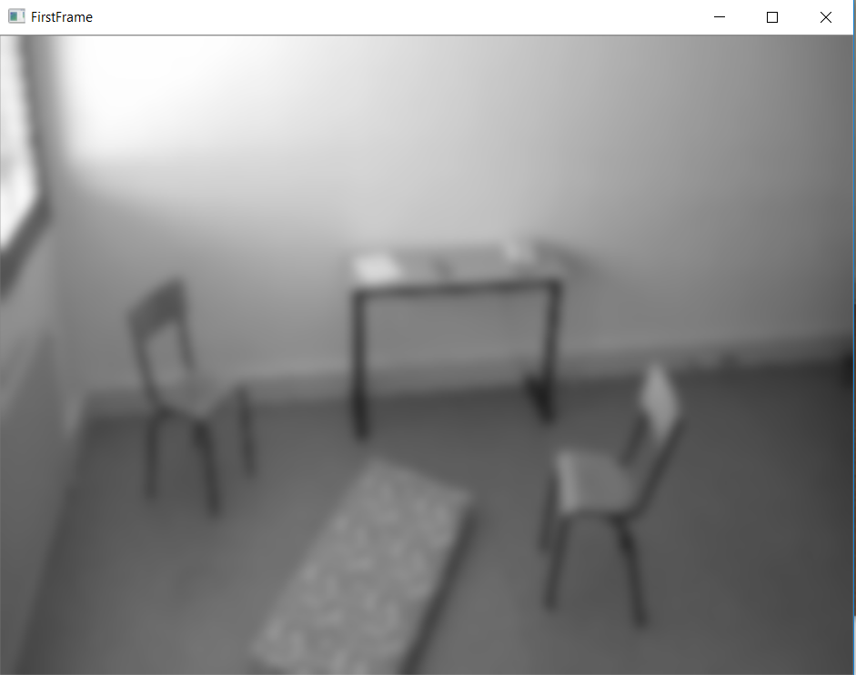
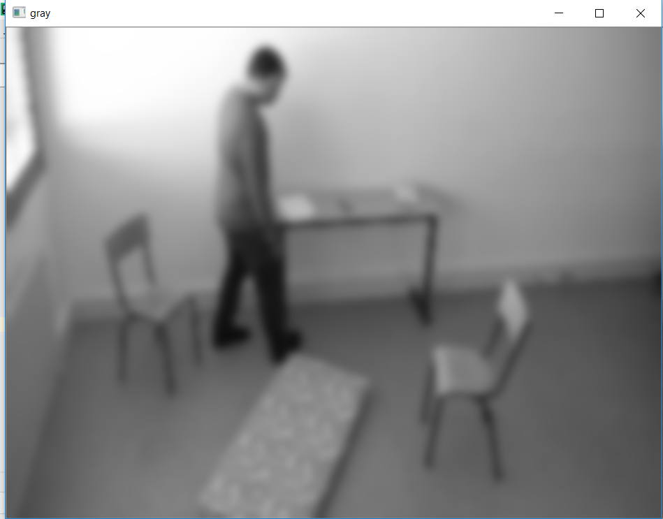
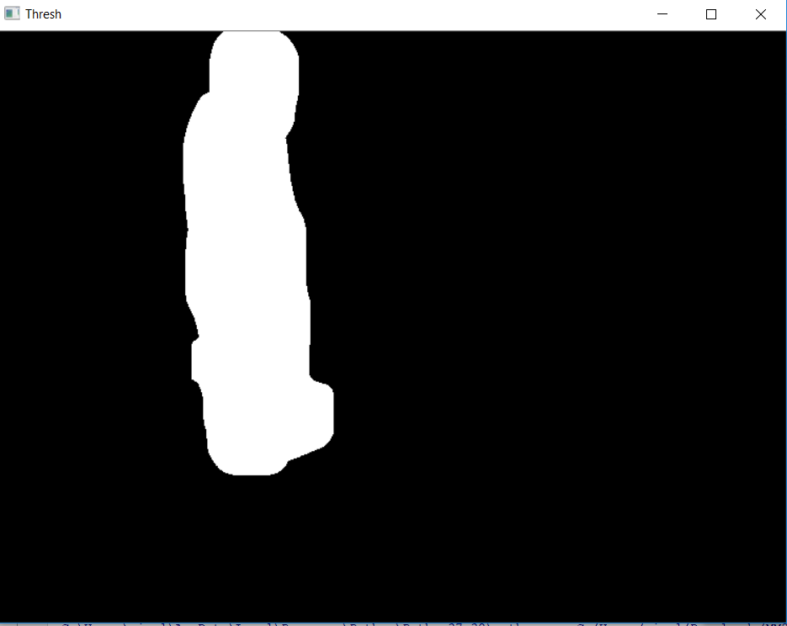
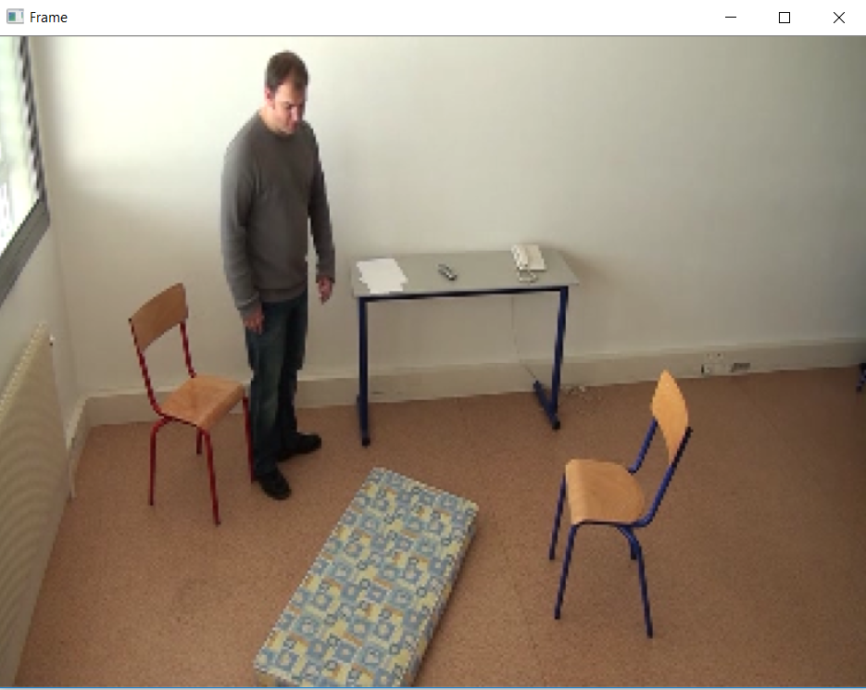

Slide 13
Detecting the fall
Calculate the angles of the contour
Switching the major and minor axis depending on the position of the contour
Calculating the speed of change of the angle which will give the fall, while trying to optimize the code to reduce the false positives while interaction.

Slide 14
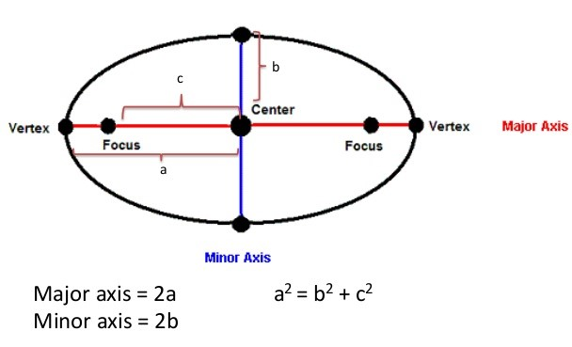
Detecting Fall ----

Slide 15
Results
Accuracy | Precision | Recall
88 | 93.75 | 78.9
Precision = True Positive / (True Positive + False Positive)
Recall = True Positive / (True Positive + False Negative)
A method for real-time detection of human fall
from video
M. Kreković, P. Čerić, T. Dominko, M. Ilijaš, K. Ivančić, V. Skolan i J. Šarlija
Sveučilište u Zagrebu Fakultet elektrotehnike i računarstva
Zavod za elektroničke sustave i obradbu informacija
Zagreb, Hrvatska
E-mail: miranda.krekovic@fer.hr claims the accuracy of 90% but no Precision and recall values were provided nor was the dataset.

Slide 16
Future scope
Better identify ROI in case of noise.
Improve working when camera is attached on top of the door.
Improve working when a person goes behind an object.
Improve when first frame is not empty.

Slide 17
Thanks! Questions!!! ???

